Slide 1
Preventing Overfitting with Ridge and Lasso Regression
Scott O’Hara
Metrowest Developers Machine Learning Group
03/28/2018

Slide 2
References
Applied Machine Learning in Python
University of Michigan, Prof. Kevin Collins Thompson
https://www.coursera.org/learn/python-machine-learning/home/welcome
Machine Learning: Regression
University of Washington, Profs. Emily Fox & Carlos Guestrin
https://www.coursera.org/learn/ml-regression/home/welcome
CS181 Intelligent Machines: Perception, Learning and Uncertainty
Harvard University, Prof. David Parkes, Spring 2011.

Slide 3
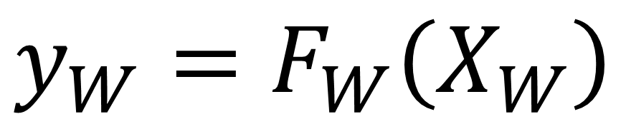
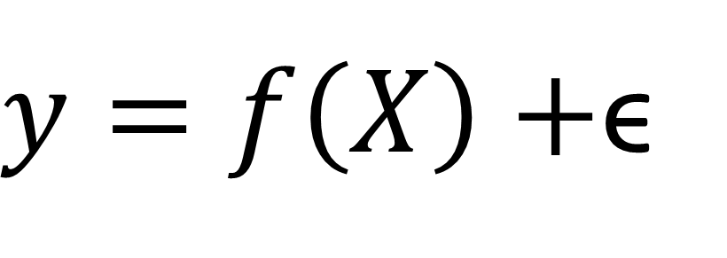
The Machine Learning Problem
AGENT
Learned
Function
Features
Prediction
Noise
$y=f\left(X\right)+$ϵ
One way of looking at machine learning is that we are trying to approximate (learn) a hidden function in the domain we are interested in so we can make predictions about that domain.
$$y_{W}=F_{W}\left(X_{W}\right)$$
WORLD

Slide 4
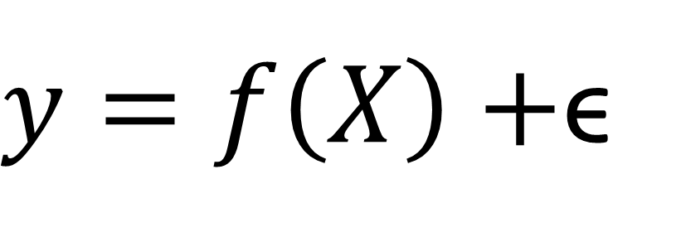
Sources of Error in Machine Learning Predictions
$y=f\left(X\right)+$ϵ
Irreducible
Error
Reducible
Error
Bias
Variance
Unmeasurable
Variables
Unmeasurable
Variation

Slide 5
Bias
Bias is the systematic error in a learning algorithm.
Bias is introduced by approximating a complex domain with a simpler model.
Bias is introduced when the model structure does not “fit” the domain.
For example, if your domain is non-linear and you try to represent it with a linear model, then there will be systematic errors.
No amount of data can fix the bias in a learning algorithm.

Slide 6
Kinds of Biases: Restriction Bias
A learning algorithm does not consider all possible classifiers / regressors but restricts the learning to task to a particular kind of solution.
For example:
Linear Classifier classifies items by partitioning the feature space with a hyperplane.
Decision Tree classifies items by projecting a tree hierarchy onto feature space.
Neural Network classifies items through the ability of features to activate neurons in a hierarchical neural structure.

Slide 7
Kinds of Biases: Preference Bias
Among possible hypotheses that a learning algorithm may consider, prefer some hypotheses over others.
For example:
Linear Classifier/Regressor: prefer weights on linear equations to be small. (Ridge and Lasso)
Decision Tree: prefer shallow trees; prefer fewer nodes; prefer higher information gain; etc.
Neural Network prefer fewer hidden units.

Slide 8
Variance
Variance is the error in prediction that can be attributed to the training set.
Classification and regression algorithms require a training set to optimize the parameters of the model it creates.
Different training sets can result in different models and different prediction algorithms.
The more susceptible a machine learning algorithm is to differences in the training set, the more variance it has.

Slide 9
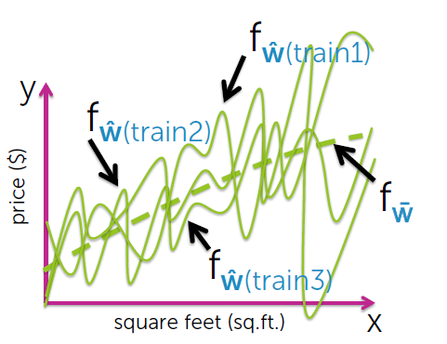
Variance in a High Complexity Model
Assume we fit a high-order polynomial
Figure Credit: Emily Fox
& Carlos Guestrin, University
of Washington

Slide 10
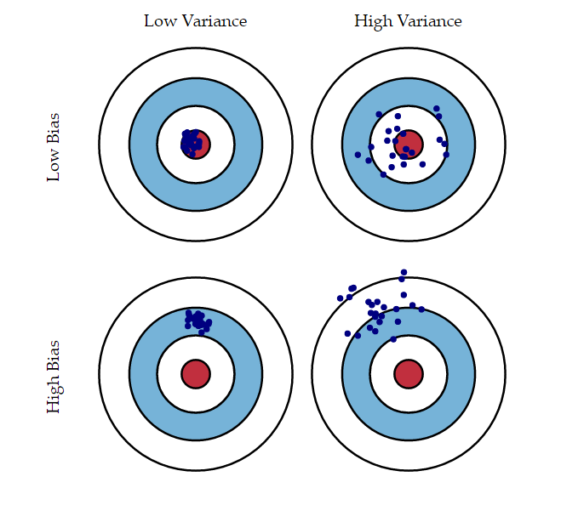
Bias and Variance
Figure Credit : An Introduction to Statistical Learning by Gareth James, Daniela Witten, Trevor Hastie, Robert Tibshirani

Slide 11
The Bias-Variance Tradeoff
Ideally, to improve a machine learning algorithm, we would like to decrease bias AND decrease variance.
Unfortunately, a decrease in bias often results in an increase in variance and vice-versa.

Slide 12
The Problem of Overfitting
Overfitting is said to occur when the test set error is much greater than the training set error.
The greater the complexity of a model, the more likely it is to fit noise or spurious patterns in the training data.
A simpler model is more immune to noise, but it unable to capture more complex relationships.
So the game becomes finding an optimal balance between bias and variance.

Slide 13
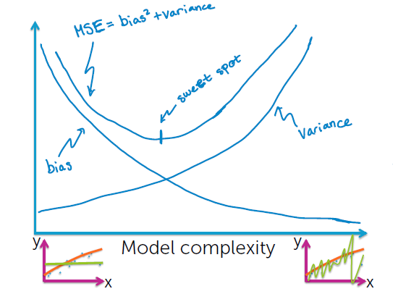
The Bias-Variance Tradeoff
Error
Figure Credit: Emily Fox
& Carlos Guestrin, University
of Washington, Coursera Machine Learning Specialization.

Slide 14
Ways to Address Overfitting: Avoid It
Use More Data: Need at least 5-10 x data for each additional parameter.
1
Use Cross-Validation: Make better use of existing data by using cross-validation. This requires greater computation.
2
Use Simpler Models: Occam’s Razer: prefer simpler explanations, restrict the classes of models to consider.
3

Slide 15

Ways to Address Overfitting: Regularization
Explicitly penalize model complexity.
Example: Decision Trees: limit tree depth.
Example: Ridge Regression -$\min_{W}\left(RMSE\right)+λw∙w$ for suitable a $λ$.

Slide 16
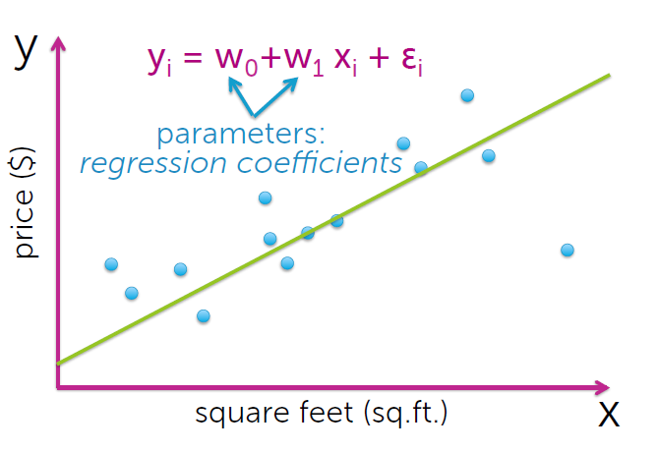
Simple Linear Regression
Figure Credit: Emily Fox
& Carlos Guestrin, University
of Washington

Slide 17
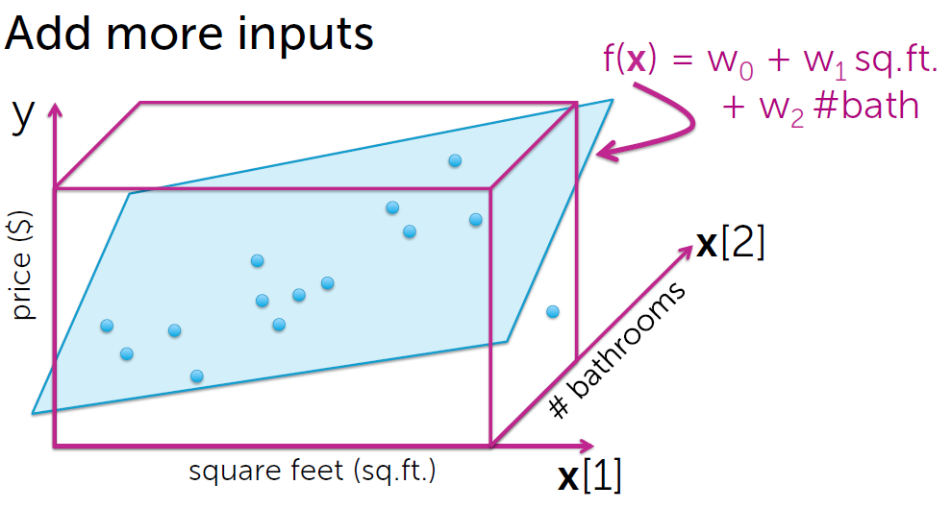
Multiple Linear Regression
Figure Credit: Emily Fox
& Carlos Guestrin, University
of Washington

Slide 18
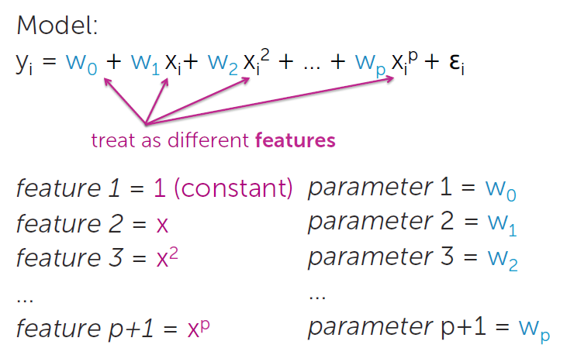
Polynomial Regression
Figure Credit: Emily Fox
& Carlos Guestrin, University
of Washington

Slide 19
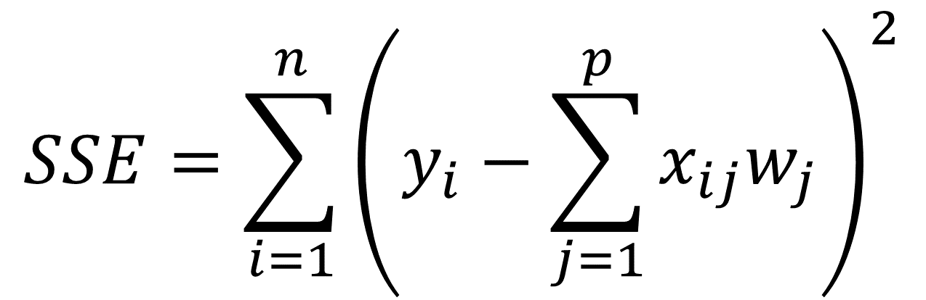
Error Sum of Squares
$$SSE=\sum_{i=1}^{n}{{\left(y_{i}−\sum_{j=1}^{p}{x_{ij}w_{j}}\right)}^{2}}$$

Slide 20
LASSO and Ridge Regression
A tuning parameter is added which lets you change the complexity or smoothness of the model.
The regularization value imposes a special penalty on complex models.

Slide 21
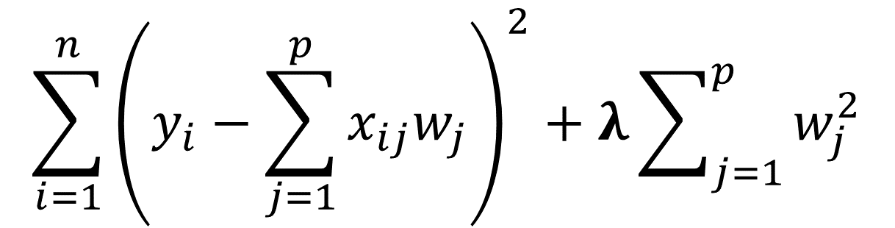

L2 Regularization – Ridge Regression
The L2 penalty is the sum of the square of the weights.
Adds “squared magnitude” of coefficient as penalty term to the loss function.
Penalizes large coefficients, which are associated with overfitting in linear regression.
$$\sum_{i=1}^{n}{{\left(y_{i}−\sum_{j=1}^{p}{x_{ij}w_{j}}\right)}^{2}+λ\sum_{j=1}^{p}{w_{j}^{2}}}$$
Figure Credit: Adapted from Gene Olafsen, Regularization, 3/14/18

Slide 22
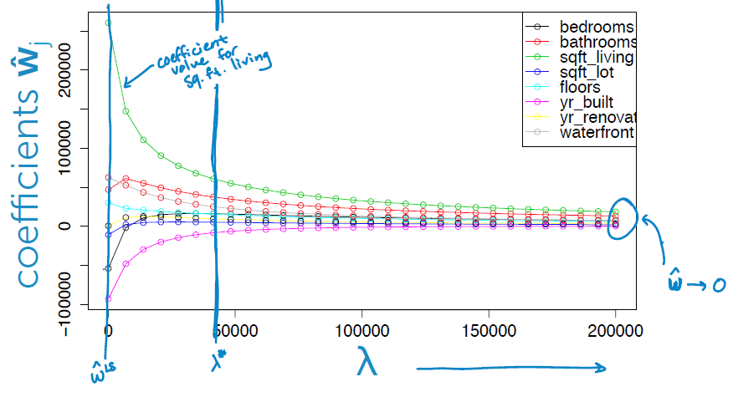
Change in Weights as Lambda Increase (L2)
Figure Credit: Emily Fox
& Carlos Guestrin, University
of Washington

Slide 23
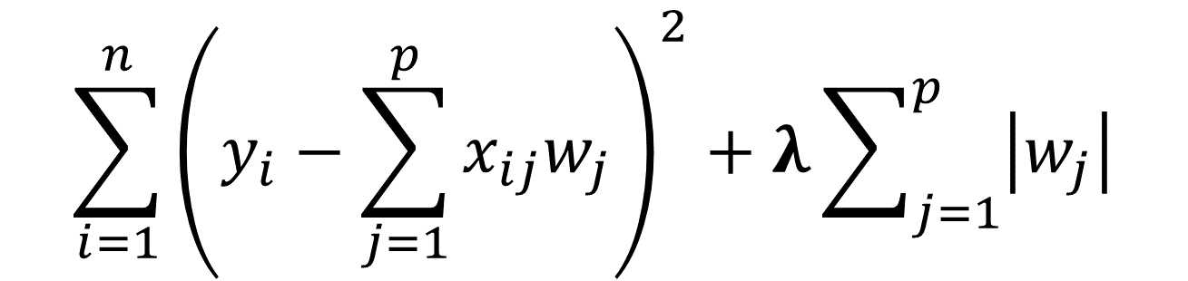
L1 Regularization – LASSO Regression
The L1 penalty is the sum of the weight magnitudes.
Lasso shrinks the less important feature’s coefficient to zero removing some feature altogether. This works well for feature selection in cases having a huge number of features.
As lambda increases, the number of non-zero weights decreases.
$$\sum_{i=1}^{n}{{\left(y_{i}−\sum_{j=1}^{p}{x_{ij}w_{j}}\right)}^{2}+λ\sum_{j=1}^{p}{\left|w_{j}\right|}}$$
Figure Credit: Adapted from Gene Olafsen, Regularization, 3/14/18

Slide 24
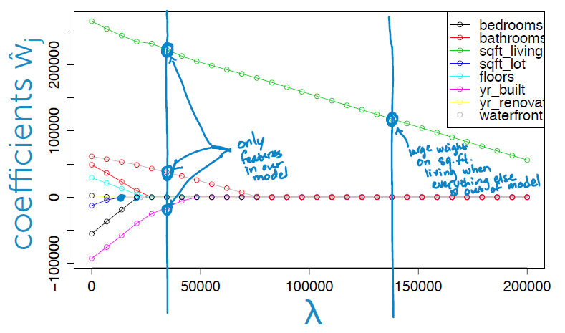
Change in Weights as Lambda Increase (L2)
Figure Credit: Emily Fox
& Carlos Guestrin, University
of Washington

Slide 25
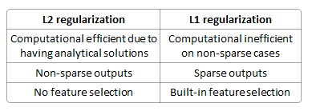
L1 and L2 Summary
Figure Credit: Gene Olafson, Regularization 3/14/18

Slide 26
Preventing Overfitting with Ridge and Lasso Regression
Scott O’Hara

Slide 27
Other Slides

Slide 28
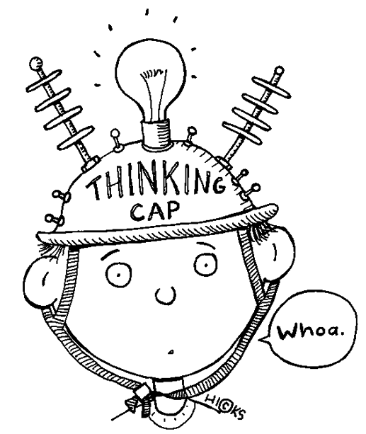



A Highly Biased Classification Algorithm ()
Not
Dog
Not
Dog
Labels:
Dog
Dog
Dog
Dog
Dog
Training Set:

Slide 29


A Highly Biased Classification Algorithm (2)
Predictions:
Dog
Dog
Dog
Dog
Dog
Dog
Dog
Test Set:
Accuracy: 43%

Slide 30
More Data Reduces Over-Fitting

Slide 31
Inductive Bias
In order for learning to be possible, one needs to make assumptions about what it is one wants to learn. This implies that some true concepts are considered more likely than others.
Consider Nelson Goodman’s Grue concept:
“All emeralds are green”
“All emeralds are grue” (grue = green before Jan 2100, blue afterwards)
Clearly, we are biased toward the first concept.

Slide 32
Inductive Bias ≠ Bias
Inductive Bias refers to the set of assumptions that the learner uses to predict outputs given inputs that it has not encountered. E.g., Occam’s razor, minimum description length, minimum cross-validation error etc.
Bias refers to the systematic error of a prediction algorithm, as we have seen.

